Slide 1

Analyzing IMDb Movie Ratings and Reviews by DSF-PH2-Group 9

Slide 2

Group Members
Petronilla Nyandwaro
Roy Njuguna Gichia
Christine Ambasa
Stanley Maina
Sylvanus Raringo
Maureen Maina

Slide 3
Table of contents
01. Introduction to IMDb Movie Ratings and Reviews
02. Research Questions
03. Data Source and Understanding
04. High-Performing Genres
05. Key Attributes for Higher Ratings
06. Impact of Audience Engagement
07. Trends in Movie Ratings Over Time
08. Recommendations for Future Film Productions
09. Conclusion

Slide 4

Introduction to IMDb Movie Ratings and Reviews Analysis
Project Overview: Analyzing IMDb movie ratings and reviews to uncover insights into audience preferences and film success. Focus on a dataset containing 73,856 entries, including key metrics like ratings, genres, budgets, and box office performance.
Goals and Research Questions: Identify high-performing genres and their box office success. Evaluate key attributes contributing to higher audience ratings. Investigate the impact of audience engagement on movie ratings. Observe trends in movie ratings over time. Provide recommendations for future film productions.
Importance to Stakeholders: Offers actionable insights for a new movie studio to inform production strategies. Enhances understanding of audience engagement and preferences, guiding marketing and content creation efforts. Visualizations will be included to illustrate key findings and trends.

Slide 5
Research Questions
Box Office Performance: Which genres are currently performing the best at the box office?
Audience Ratings: What key attributes contribute to higher audience ratings?
Audience Engagement: How does audience engagement impact movie ratings?
Trends Over Time: What trends can be observed in movie ratings over time?
Future Recommendations: What recommendations can be made for future film productions?

Slide 6
Data Source and Understanding
Overview of the IMDb Dataset
Contains 73,856 entries with 8 key attributes related to movies.
Attributes include audience ratings, genres, production budgets, release years, and box office performance.
Data Types and Structure
Data types include integers, floats, and objects, ensuring a comprehensive analysis of film metrics.
Key columns: movie id, primary title, start year, runtime minutes, genres, average rating, and numvotes.
Limitations and Gaps
Missing values in start year, runtime minutes, and genres may affect analysis accuracy.
Older and independent films may have incomplete financial data and limited audience reviews, impacting overall insights.

Slide 7
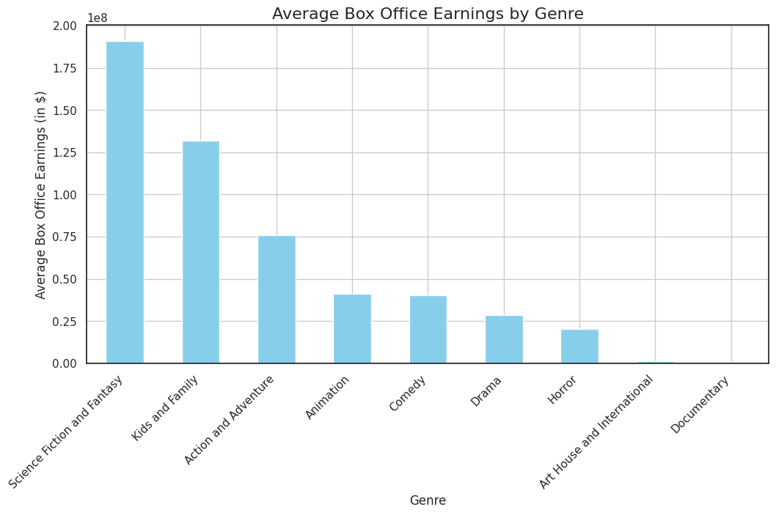
High-Performing Genres
1. Identify Top Genres
Analyze the dataset to determine which genres consistently achieve high average ratings and box office success. Notable genres include Drama, Action, and Documentary.
2. Assess Impact on Production Strategy
Utilize insights from genre performance to inform the studio's content creation strategy, ensuring alignment with audience preferences and market trends.
3. Explore Niche Sub-Genres
Consider the potential of niche sub-genres such as Crime and Biography, which can appeal to dedicated fan bases and enhance overall box office performance.
4. Examine Audience Preferences
Investigate how these high-performing genres resonate with audiences, focusing on their popularity and engagement levels. For instance, Drama films often attract a broad audience due to their relatable theme
5. Recommendations for Future Productions
Develop a content strategy that prioritizes high-performing genres while also exploring innovative storytelling within niche sub-genres to maximize audience engagement and box office success.

Slide 8
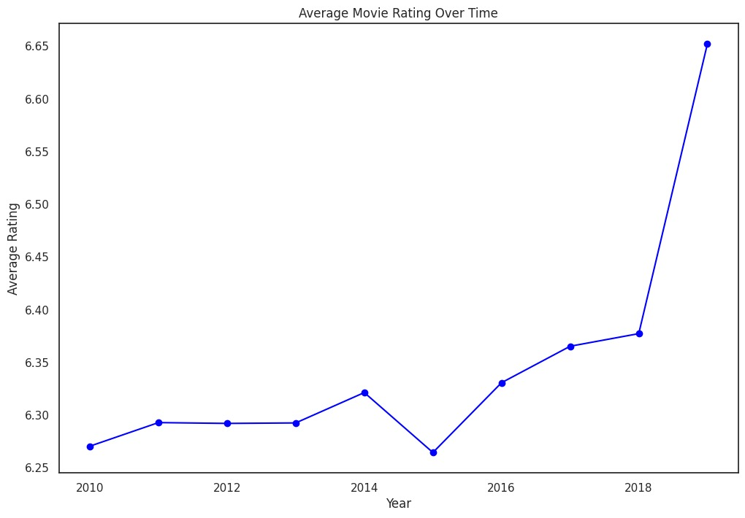
Key Attributes for Higher Ratings
1. Analyze Runtime
Examine the correlation between movie runtimes and audience ratings. Research indicates that films with runtimes between 380-400 minutes tend to receive better ratings and higher audience engagement
2. Evaluate Release Year Trends
Investigate how the release year impacts ratings. A steady increase in movie ratings over the years suggests that advancements in technology and higher production budgets may contribute to improved audience perceptions.
3. Assess Audience Engagement
Explore the relationship between the number of votes and average ratings. Higher engagement, indicated by a greater number of votes, often correlates with better ratings, highlighting the importance of audience interaction in determining a film's success.

Slide 9
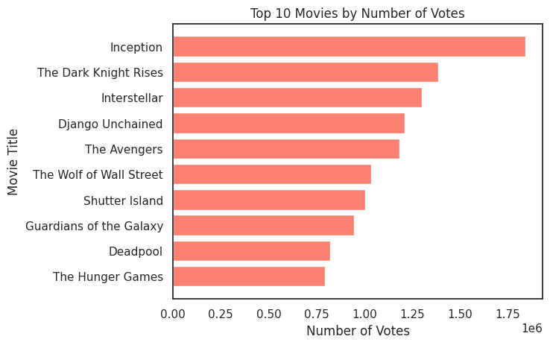
Impact of Audience Engagement
Understanding Audience Engagement
Investigate the relationship between the number of votes and average ratings to gauge how audience participation influences film success.
2. Analyzing Viewer Preferences
Identify trends in audience engagement by examining which genres receive the most votes, highlighting the connection between engagement and ratings.
3. Significance of High Engagement
Recognize that higher audience engagement often correlates with better ratings, suggesting that films with more votes tend to be perceived more favorably.
4. Strategies for Enhancing Visibility
Develop marketing strategies that encourage audience interaction, such as social media campaigns and viewer polls, to boost engagement and ratings.
5. Recommendations for Future Productions
Utilize insights from audience engagement data to inform film production decisions, focusing on genres and attributes that resonate with viewers to maximize box office success.

Slide 10
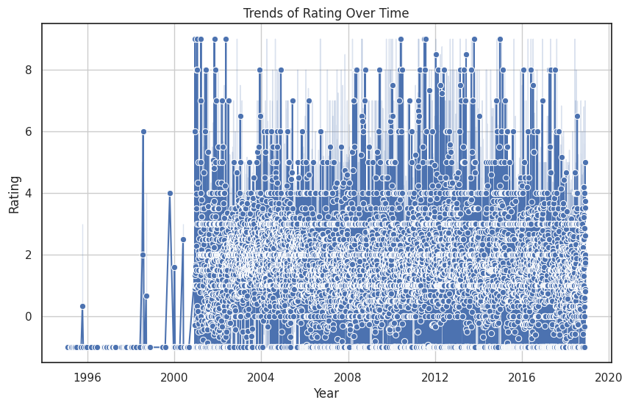
Trends in Movie Ratings Over Time
1. Steady Increase in Ratings
Over the years, there has been a consistent rise in movie ratings, potentially linked to higher production budgets and advancements in filmmaking technology.
2. Annual Movie Releases
The number of movies released each year has generally increased, with a notable exception in 2018, which may have influenced audience ratings and engagement.
3. Viewer Engagement Patterns
Action movies have garnered the most votes, indicating a strong viewer engagement trend that correlates with higher ratings.
4. Runtime Impact
Analysis shows that movies with runtimes between 380-400 minutes tend to achieve better ratings, suggesting a preference for longer films among audiences.

Slide 11

Recommendations for Future Film Productions
Investing in high rating Genres: Focus on producing films in Drama, Action, and Documentary genres to capture consistently engaged audiences. Explore sub-genres such as Crime or Biography to appeal to niche markets.
Optimize Runtime for Success: Target runtimes between 120–150 minutes to strike a balance between audience satisfaction and financial performance, as excessively long or short films may deter viewers.
Leverage Star Power: Collaborate with renowned actors and directors to increase the likelihood of commercial success, as their involvement significantly boosts audience interest and box office returns.
Expand International Marketing: Utilize the strong domestic-foreign gross correlation by tailoring marketing strategies to global audiences, especially for movies that perform well domestically.
Monitor and Adapt to Trends: Continuously analyze yearly trends and audience preferences to identify emerging genres or themes, ensuring content aligns with current market demands and maximizes profitability.

Slide 12

Next Steps
Analyze Studio Performance
Look deeper into how different studios perform financially to find key players and potential partners.
Study Yearly Trends
Review how movie revenues and audience preferences change each year to plan better release strategies.
Understand Audience Groups
Break down audience data by age, gender, and region to target specific groups with the right genres or runtimes.
Focus on Global Markets
Explore new regions or countries where movies could perform well to reach more audiences and grow revenue.
Test Budget Strategies
Create movies with different budget sizes to see which approach gives the best return and works best for specific genres.

Slide 13

Conclusion
Project Recap: This analysis aimed to explore IMDb movie ratings and reviews to identify high-performing genres, key attributes influencing audience ratings, and trends in viewer engagement over time.

Slide 14


THANK YOU
GitHub

